Slide 1

Anomaly Detection
Finding What Doesn't Belong — From Statistical Outliers to Isolation Forest
MACHINE LEARNING · DATA SCIENCE · B.TECH

Slide 2
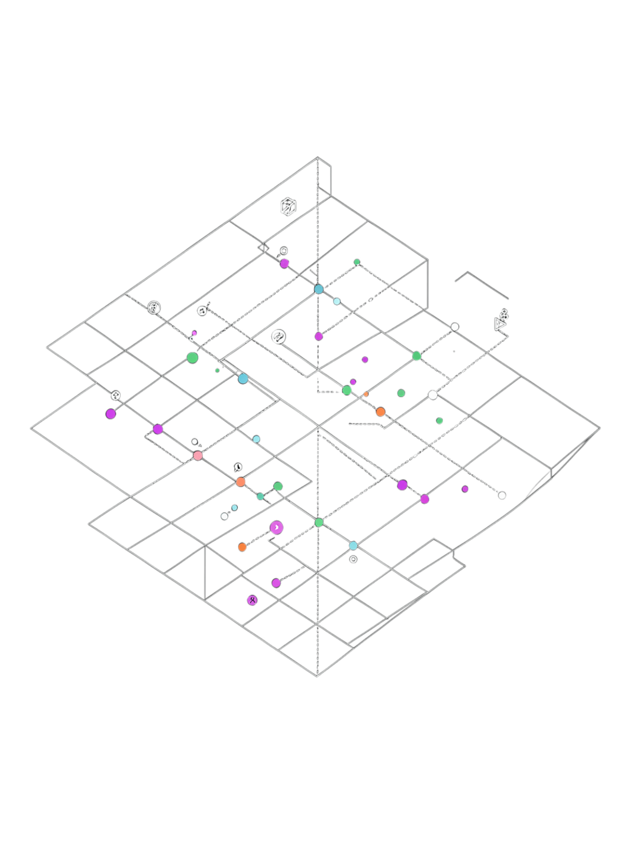

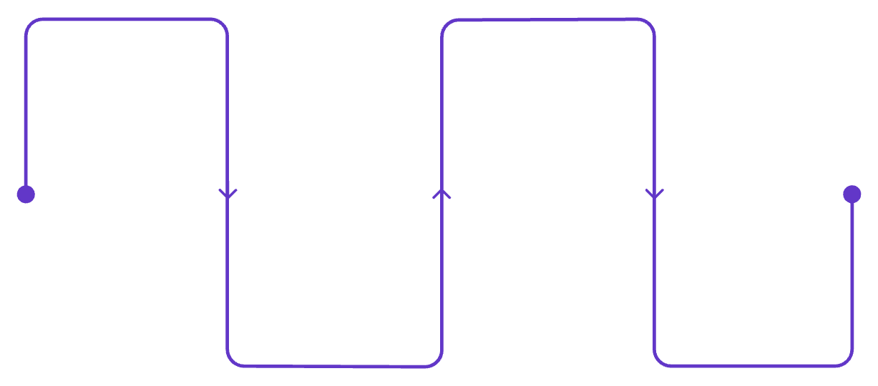

What Is an Anomaly?
An anomaly is an observation that differs substantially from the expected pattern of the data.
Real-World Examples
Credit card transaction of unusual amount
Network request with unusual behavior
Sensor reporting extreme temperature
Manufacturing machine with abnormal vibration
Medical measurement outside expected range
The Detection Pipeline
Raw Data
Identify Unusual
Collect sensor and logs
Detect deviations from norm
Learn Normal
Investigate / Alert
Model expected behavior
Analyze and notify stakeholders
Anomaly ≠ Automatically an Error. It can be fraud, equipment failure, a rare event, or a legitimate but unusual observation.

Slide 3
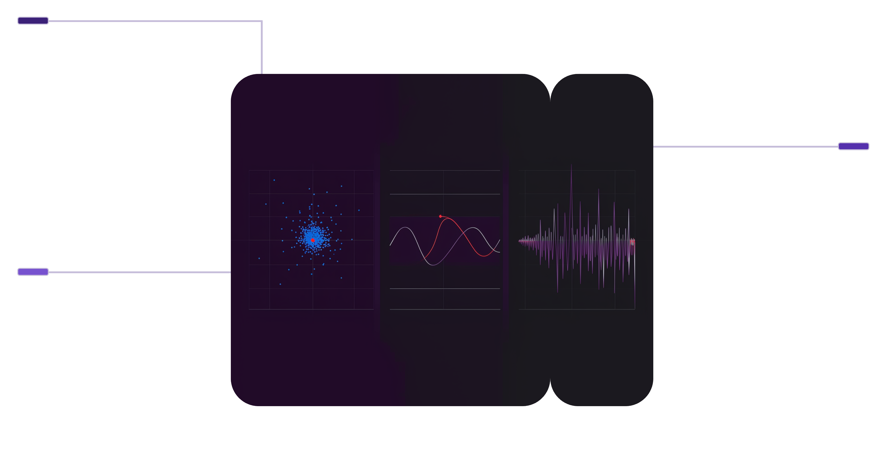
Not All Anomalies Look the Same
1 — Point Anomaly
2 — Contextual Anomaly
3 — Collective Anomaly
A single observation is dramatically unusual compared to the rest of the dataset.
Example: Most transactions: ₹100–₹2,000
One transaction: ₹95,000
A point is unusual only within a specific context — time, location, or conditions matter.
Example: Temperature = 35°C
Normal in summer · Unusual in winter
Context: Season + Location + Time
A group or sequence is unusual even if individual points appear normal.
Example: Normal: 10, 11, 9, 12, 10…
Then: 100 requests in 3 seconds
No single point is extreme — the pattern is.
Point Anomaly
One isolated red point far from blue cluster
Contextual Anomaly
Seasonal series with a red spike in wrong season
Collective Anomaly
Stable series then sudden burst of spikes

Slide 4





From Intuition to Anomaly Score
Every observation receives an anomaly score: f(x) — measuring how unusual x is.
Statistical
"How unlikely is this observation?"
Z-score, Gaussian models
Observation
Apply Threshold
Collect input data x
Compare score to threshold
Distance / Density
"How far from normal observations?"
k-NN, Local Outlier Factor
Compute Score
Decision
Calculate anomaly score f(x)
Normal (low) or Anomaly (high)
Isolation
"How easily can this be isolated?"
Isolation Forest
There is no universal anomaly detector best for every dataset. Method choice depends on data distribution, dimensionality, and available labels.

Slide 5
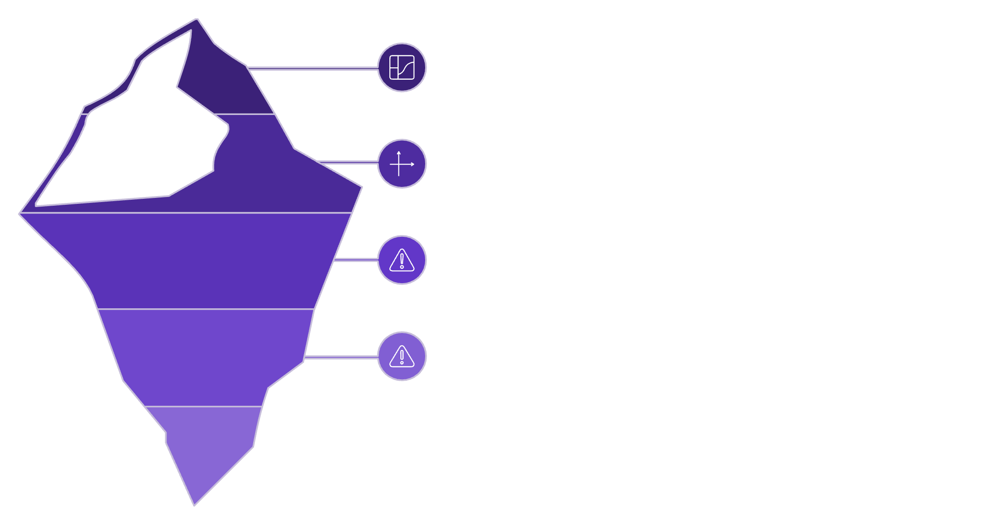

Statistical Anomaly Detection — Z-Score
Worked Example: Transaction Amounts
Normal Range
Mean: μ = ₹500
Standard deviation: σ = ₹100
New transaction: x = ₹900
μ, μ+1σ, μ+2σ
Z-Score Formula:
μ+3σ (Threshold)
Tail & Anomaly
The observation is 4 standard deviations above the mean.
Rule of Thumb
Limitations
|z| > 3 may indicate an unusual observation requiring investigation.
Works best when distribution assumptions hold. Extreme outliers can distort mean and standard deviation estimates.

Slide 6

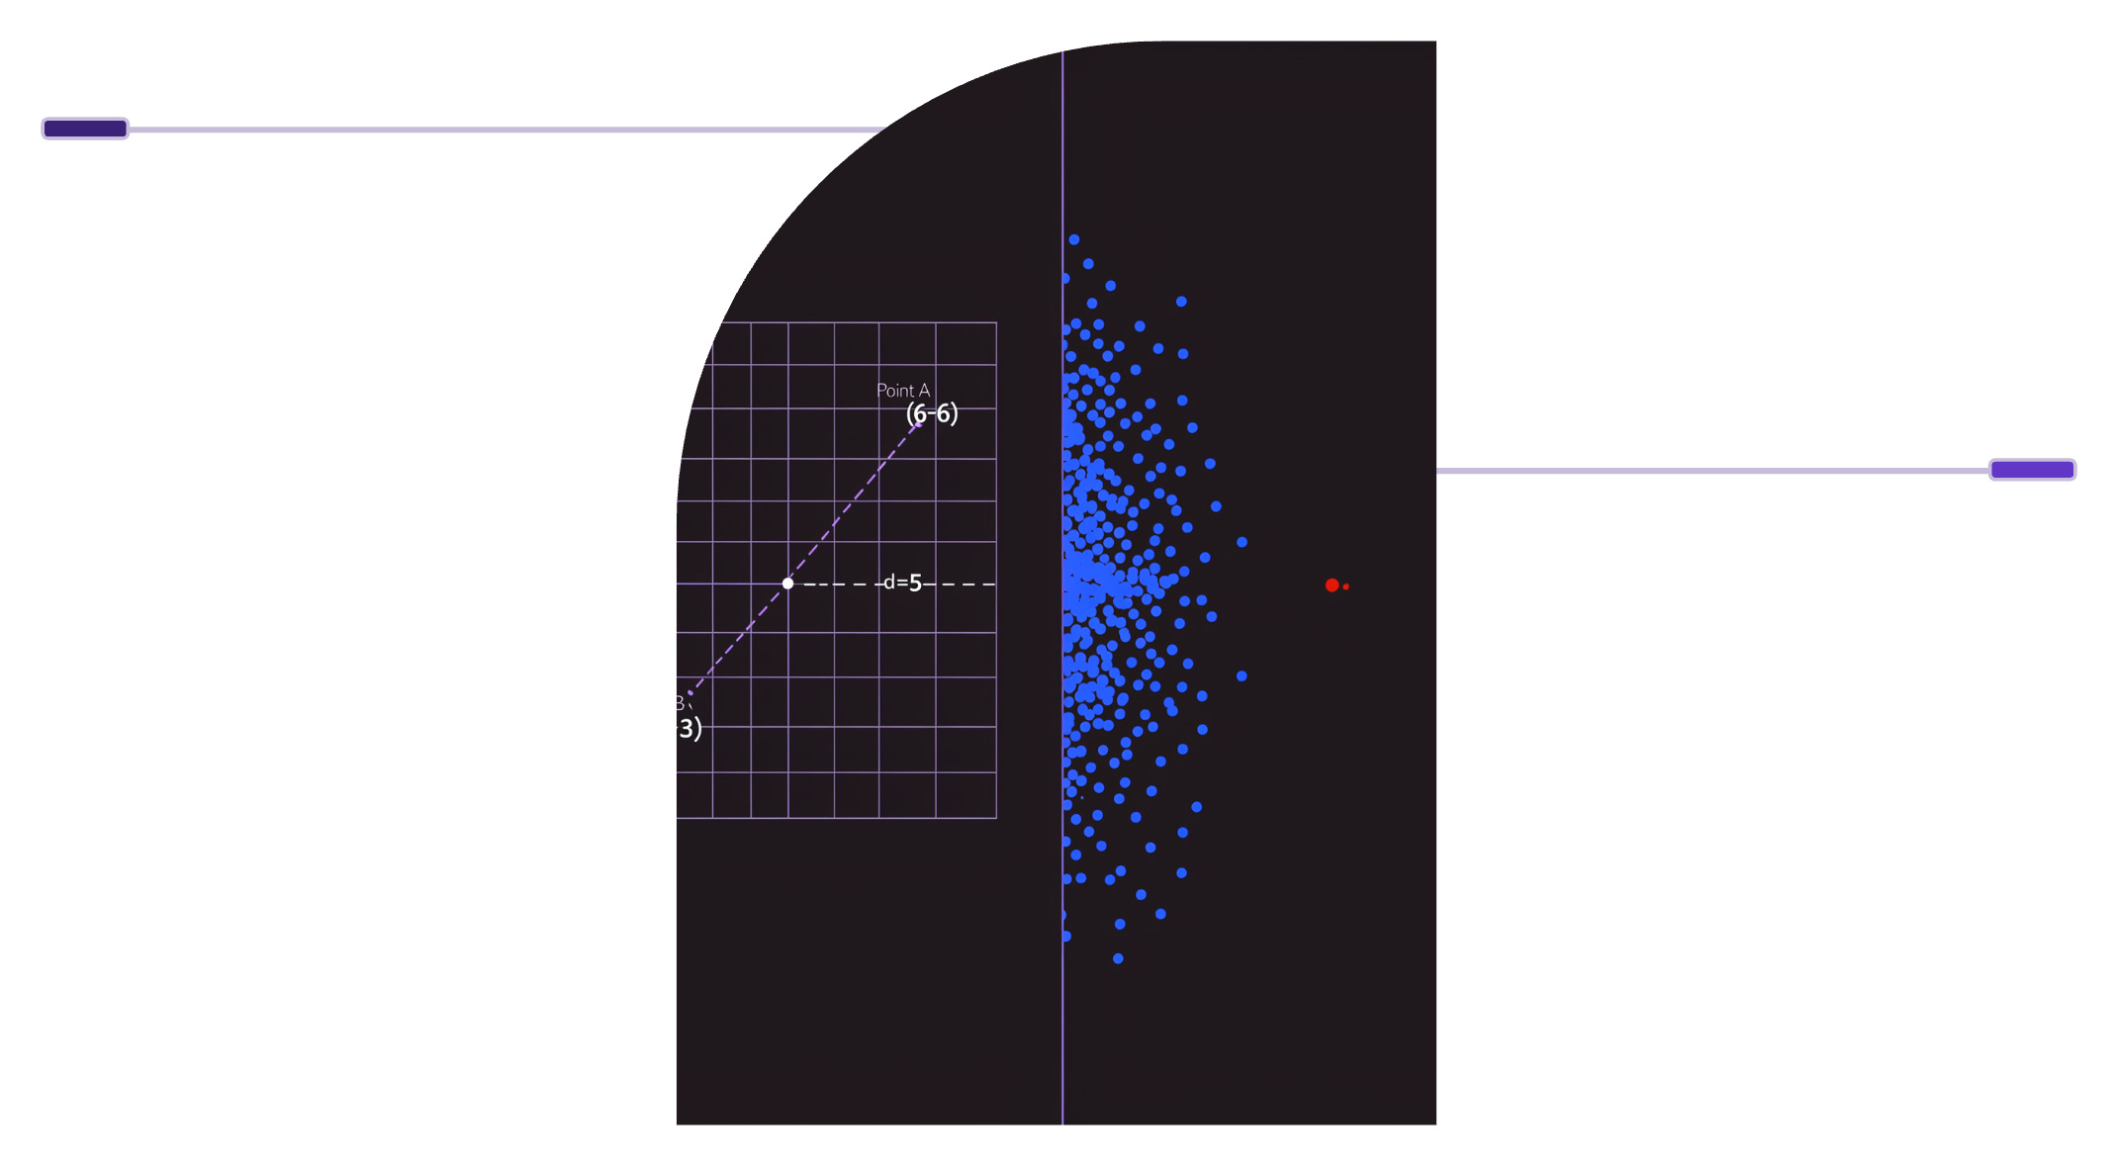
Distance & Density Based Detection
Method 2 — Euclidean Distance
General Formula (n dimensions):
Distance Example
Two-Dimensional Case:
Point A (2,3) and B (6,6) with d = 5.
Density Anomaly
Worked Example:
Dense blue cluster vs single red low-density anomaly.
Point A: (2, 3) — Point B: (6, 6)
d(A,B) = √[(6−2)² + (6−3)²] = √(16+9) = √25 = 5
Local Density Approach (LOF)
Normal region: HIGH local density
Anomalous region: LOW local density
Local Outlier Factor compares local density with neighbors

Slide 7
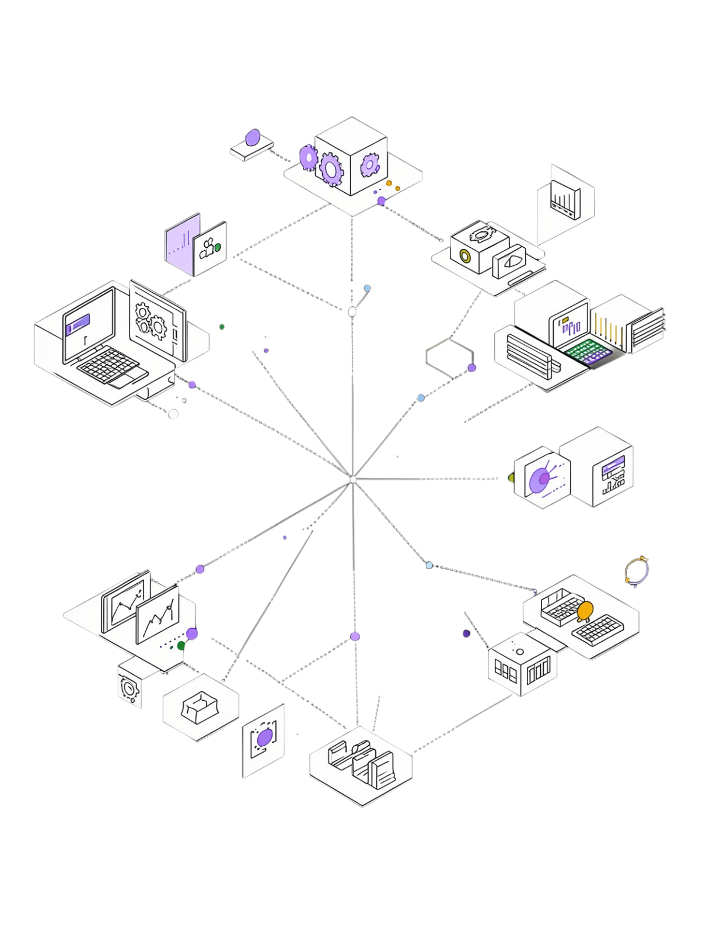


Isolation Forest — Core Intuition
Key Insight
Anomalies are easier to isolate than normal points. Isolation Forest builds many random trees and measures how quickly each observation becomes isolated.
Normal — Long Path
Many splits (blue)
Anomaly — Short Path
Isolated quickly (red)
Isolation Forest does NOT model normality by estimating a probability distribution — it exploits isolation path length directly.
Feature < 80?
Secondary split check
Feature < 50?
First split decision
Normal Points
Anomalies
Surrounded by many similar observations → require MORE random splits to isolate → LONG PATH
Isolated from majority → require FEWER random splits → SHORT PATH

Slide 8

Isolation Forest — Mathematics
Path Length & Anomaly Score
h(x) = number of edges to isolate x in one tree
E[h(x)] = average path length across all trees
Shorter E[h(x)] → more anomalous
Longer E[h(x)] → more normal
Many Random Trees
Compute E[h(x)]
Anomaly Decision
Anomaly Score Formula
Average across trees
Classify NORMAL/AMBER/RED
Build isolation trees
Normalization factor:
Measure Path Lengths h(x)
Calculate s(x,n)
Count edges to isolate
Convert to anomaly score
where H is the harmonic number, n is sample size.
Score Interpretation
E[h(x)] small → s → 1 → Strong Anomaly
E[h(x)] large → s → 0.5 or lower → Normal

Slide 9
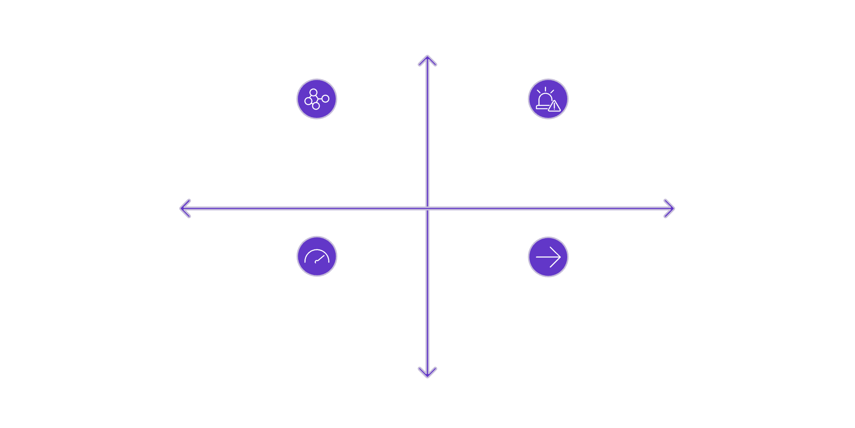
Worked Example — Isolation in Action
Daily Transaction Amounts (₹)
100, 110, 105, 120, 115, 108, 112, 118, 125, 900
Statistical Analysis
High Frequency
Mean ≈ ₹181.3 (heavily distorted by 900)
Key lesson: Outliers skew statistical measures — Z-score can be unreliable when the anomaly is extreme
Normal Region (9 transactions)
Isolated Observation — Strong Anomaly
Low Amount
High Amount
Isolation Forest Perspective
Random split on transaction amount
Value 900 isolated with very few splits
Short path length → High anomaly score
Low Frequency Gap
Typical Cluster Arrow
Low Frequency
Real decisions depend on: algorithm choice, contamination assumptions, feature scaling, data distribution, and threshold selection.

Slide 10

Python Implementation & Evaluation
scikit-learn — Isolation Forest
import pandas as pd
from sklearn.ensemble import IsolationForest
from sklearn.preprocessing import StandardScaler
X = df[['amount', 'frequency']]
X_scaled = StandardScaler().fit_transform(X)
model = IsolationForest(
n_estimators=200,
contamination=0.02,
random_state=42
)
model.fit(X_scaled)
predictions = model.predict(X_scaled)
df['anomaly'] = predictions
# Get continuous anomaly scores
scores = model.decision_function(X_scaled)
df['anomaly_score'] = scores
Detection Pipeline
Raw Data
Cleaning
Scaling
IsolationForest
Sample Output
Transaction | Score | Prediction
T101 | −0.03 | Normal
T102 | −0.01 | Normal
T103 | −0.42 | Anomaly
Accuracy is misleading when anomalies are rare. Use Precision, Recall, F1, PR-AUC, or ROC-AUC instead.
+1 → Inlier
−1 → Outlier
Normal observation
Flagged anomaly

